Slide 1
SQL PROJECT
Walmart

Slide 2
Introduction to the project
Business Problem We Have:
Walmart wants to optimize its sales strategies by analyzing historical transaction data across branches, customer types, payment methods, and product lines. To achieve this, advanced MySQL queries will be employed to answer challenging business questions related to sales performance, customer segmentation, and product trends

Slide 3
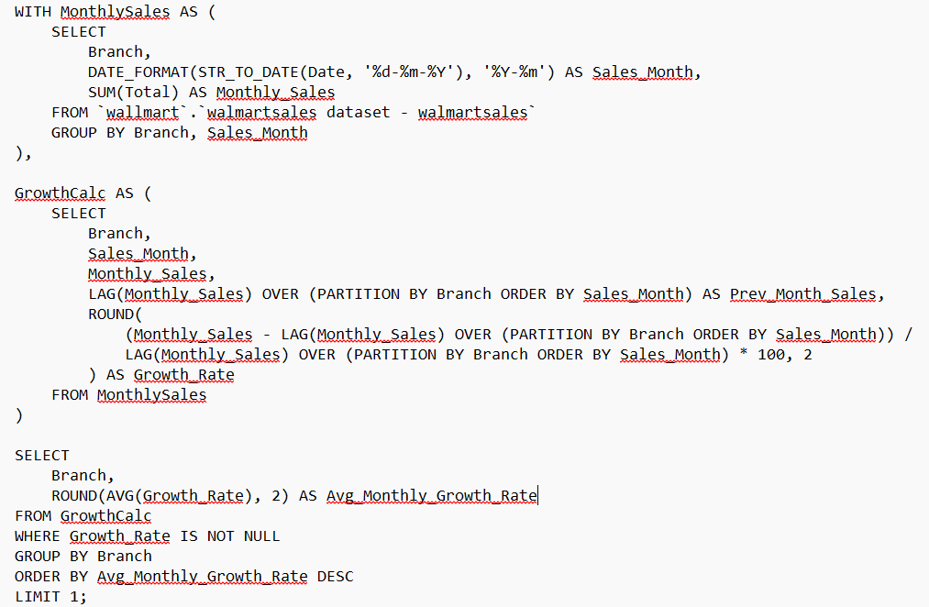
TASK 1
Queries and Output
Task:
Determine which Walmart branch (A, B, or C) has the highest average month-over-month sales growth.
Insights we found:
Branch A showed the highest growth rate over time, indicating strong sales momentum and effective performance strategies.
Notes:
TASK 1

Slide 4
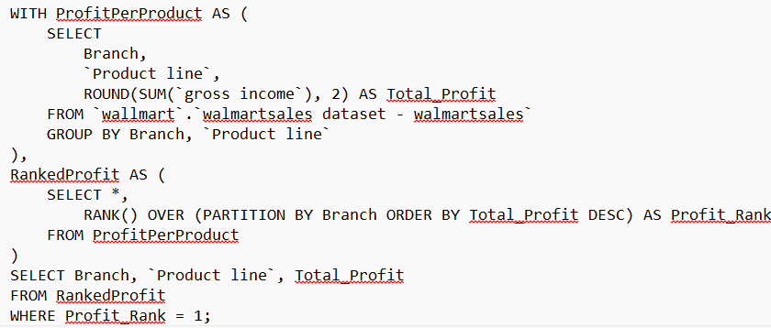
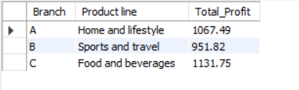
TASK 2
Queries and Output
Task:
Most Profitable Product Line for Each Branch.
Insights we found:
Each branch has a different best-selling product line, highlighting the importance of customizing inventory and promotion per location.
Notes:
TASK 1

Slide 5
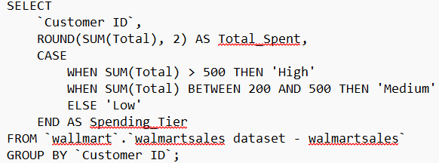
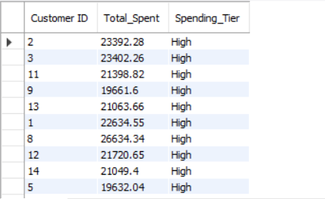
TASK 3
Queries and Output
Task:
Segment customers based on their total spending into High, Medium, and Low tiers.
Insights we found:
High-spending customers are ideal for loyalty rewards; medium and low spenders may benefit from promotional engagement.
Notes:
TASK 1

Slide 6
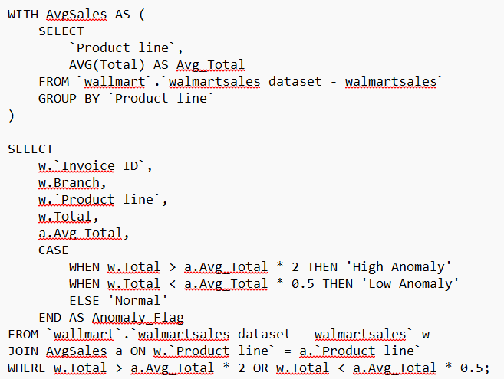
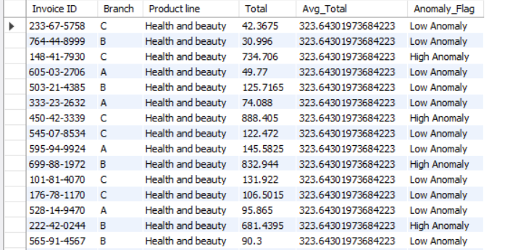
TASK 4
Queries and Output
Task:
Identify unusually high or low transactions compared to average for each product line.
Insights we found:
Anomaly_Flag could indicate fraud, bulk buying, or entry errors and need further business review.
Notes:
TASK

Slide 7
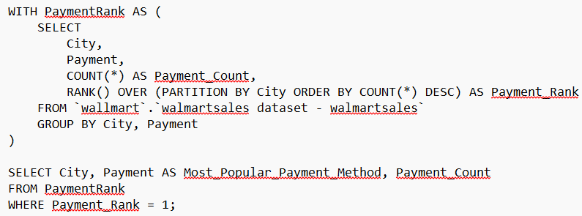
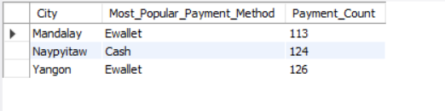
TASK 5
Queries and Output
Task:
Determine the most frequently used payment method in each city.
Insights we found:
Marketing strategies can be adapted per city based on preferred payment options (e.g., Ewallet dominance in Yangon and Mandalay).
Notes:
TASK 1

Slide 8
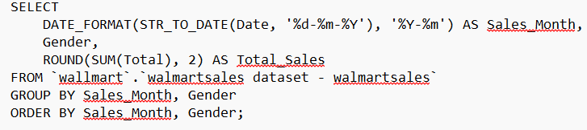
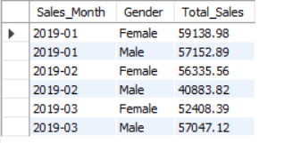
TASK 6
Queries and Output
Task:
Analyze sales distribution per month split by gender.
Insights we found:
Male customers slightly spend less than female customers in two month, which may inform gender-based promotions.
Notes:
TASK 1

Slide 9
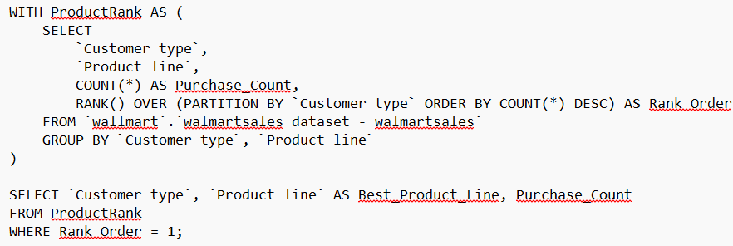
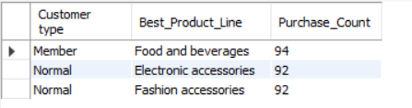
TASK 7
Queries and Output
Task:
Find which product line is most popular among Member vs Normal customers.
Insights we found:
Members prefer Food and Beverages, Normal customers lean toward Fashion Accessories and Electronic accessories.
Notes:
TASK 1

Slide 10
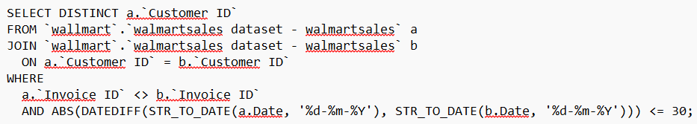
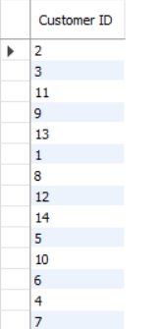
TASK 8
Queries and Output
Task:
Spot customers who made multiple purchases within a 30-day window.
Insights we found:
Repeat customers indicate high engagement and should be targeted for loyalty programs.
Notes:
TASK 1

Slide 11
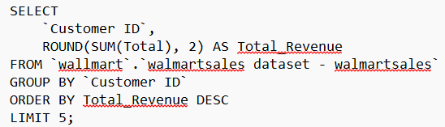
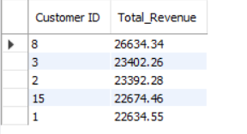
TASK 9
Queries and Output
Task:
Find the customers who generated the highest total sales.
Insights we found:
These top customers contribute significantly to revenue and should receive priority benefits.
Notes:
TASK 1

Slide 12
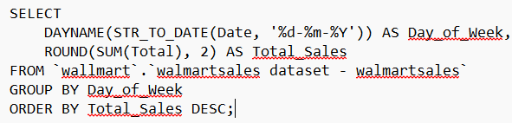
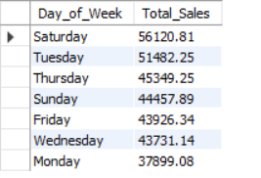
TASK 10
Queries and Output
Task:
Determine which day of the week sees the highest total sales.
Insights we found:
Saturday have the highest sales, guiding staffing and promotional strategies.
Notes:
TASK 1

Slide 13
Video explanation link: https://drive.google.com/drive/folders/150cRop48TFtPJkVmXGzQf_Z9be85PrWg?usp=sharing

Slide 14
Mentioning what I did:
I used notepad screenshot instead of workbench screenshot because some queries can not be shown in a single screenshot for some long queries.
About the output I put it right below the queries.
And I mentioned the task like questions on each one.
I mentioned the insights we found on running those queries and this step is answer that we are made to do.

